Slide 1
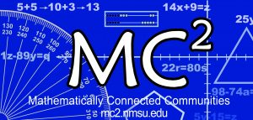
Mathematically Connected Communities
This session will be recorded and available at https://mc2.nmsu.edu/
Welcome! Please introduce yourself in the chat box by writing your name, your district, and your role in the education sector.
Purposeful Reentry and Unpacking Important Reentry Documents
August 26, 2020
5:00-6:00 pm

Slide 2
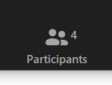
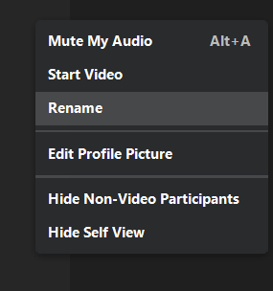
Think about which grade-level breakout room will work best for you today!
K, 1, 2, 3, 4, 5, 6, 7, 8, HS
Go to your participants icon to bring up the list of participants, find your name, and select More >Rename.
Or, hover over your image and rename yourself with your preferred grade-level and your name. For ex: 7 Allie Conway
For example: 8 Allie

Slide 3
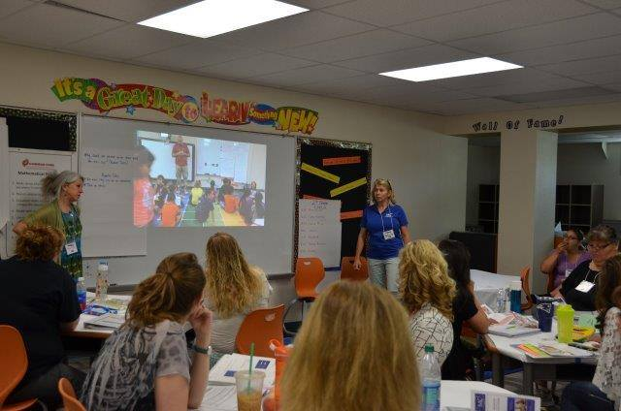
About MC²
Mathematically Connected Communities is:
A partnership of dedicated math educators, including teachers, mathematicians, researchers, and school district administrators, working collectively to improve mathematics learning for K-12 students across the state of New Mexico
Initiated with funding by the US Department of Education/ Math-Science Partnership (MSP), the NM Public Education and Higher Education Departments (PED and HED), and Title II funding by districts to strengthen the quality & effectiveness of teachers, principal, and other school leaders

Slide 4
Mathematically Connected Communities (MC²) works to improve math education through a variety of professional learning experiences which align to the New Mexico Public Education Department’s (NM PED) reentry guidance.
Four Live Web-Events Sessions
Awareness and Information: Purposeful Reentry and Adapting to Change
Unpacking Important Mathematics Reentry Documents
Structuring Accelerated Learning in Reentry
The Importance of Models in Developing Fluency

Slide 5
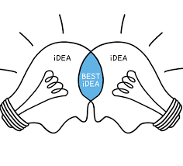
Norm Offerings for our Collaborative Session
In exploring today, what are the norm(s) you will take with you?
Invite participation by using names
Honor individual thinking and learning time
Ask questions
Expect to share
Reflect on where you want to grow
Other?

Slide 6
How did quarantine impact our tech habits?
Card Sort: https://teacher.desmos.com/activitybuilder/custom/5ec598c4ddc3c901dfc053ca

Slide 7
Can we model generosity with mathematics?
Which of these bushfire relief donors was the most generous?
Source: https://blog.mrmeyer.com/category/3acts/
What’s your ranking?
What information matters here?
What would your students say?

Slide 8
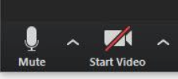
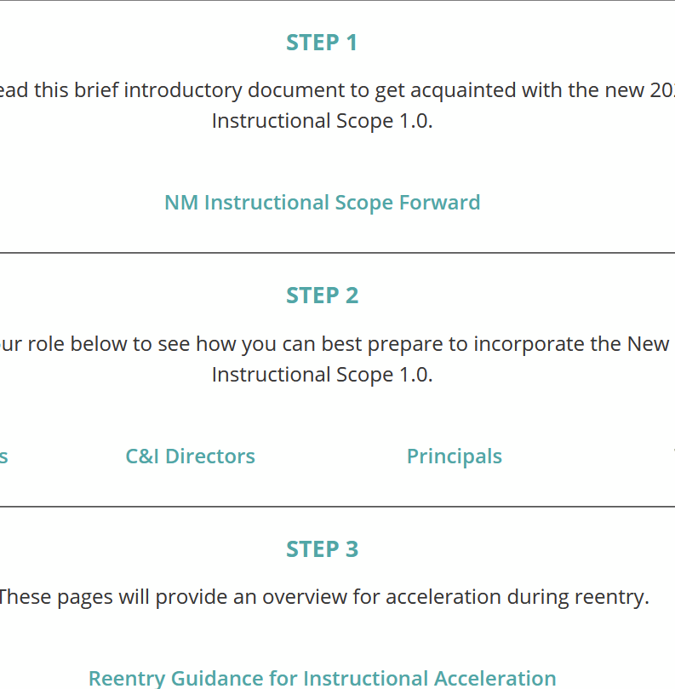
Individual Explore
As individuals, take 5 minutes to explore the Curriculum and Instruction page from the NMPED where reentry documents and links are housed.
Explore the light turquoise sections and links, what are you curious about exploring?
What do you notice? What do you wonder? When we come back, enter your ideas into the chat!

Slide 9
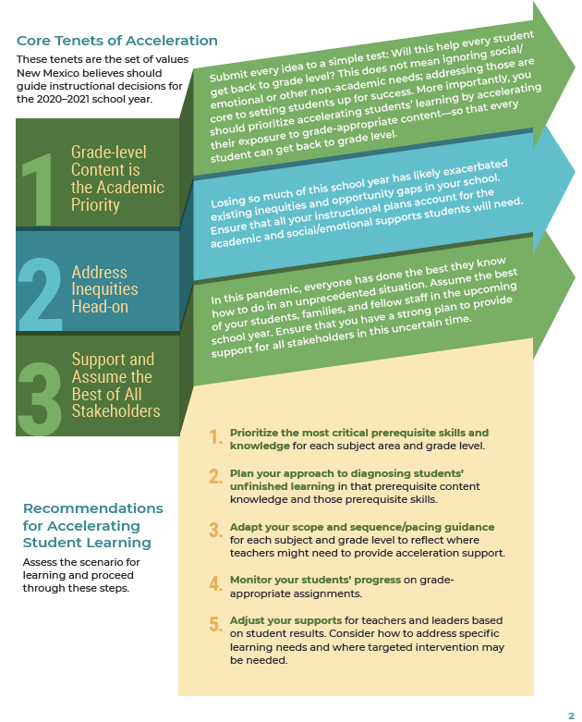
Whole Group
As a whole group, let’s explore the idea of acceleration in reentry.
Find the Core Tenets of Acceleration and Recommendations in the Reentry Guidance for Instructional Acceleration.
What resonates with you and what questions do you have? Put it into the chat.

Slide 10
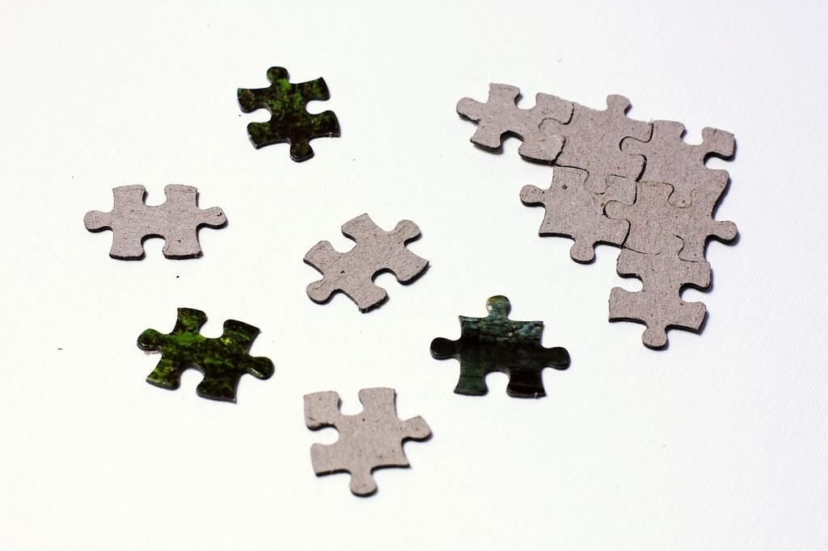
Grade-Level Breakout Rooms
K-8: Look at the Domain-specific Recommendations by Grade Bands in the Reentry Guidance Tool for Mathematics
https://webnew.ped.state.nm.us/wp-content/uploads/2020/08/New-Mexico-Math-Guidance-Document-for-Acceleration-Guide-v3.pdf
HS: Look at pp. 13-14 2020–2021 Support for Instructional Content Prioritization in High School Mathematics from Achieve the Core
Spend 5 minutes in conversation here.
https://webnew.ped.state.nm.us/wp-content/uploads/2020/08/New-Mexico-Math-Guidance-Document-for-Acceleration-Guide-v3.pdf
Now, spend some time in small group looking at grade-level specific standards in the Instructional Scope.
Find Section 2: Cluster Level Planning Support in the table of contents.
Take 15 minutes here to EXPLORE.
What resonates with you? What questions do these documents bring up for you?
https://webnew.ped.state.nm.us/bureaus/curriculum-instruction/nm-is-mathematics/

Slide 11
Reflect: What do you know now that you would share with a colleague? What have you learned that excites you about planning for students’ mathematics learning?
Link: https://student.desmos.com/join/x22772

Slide 12
Thank you!
How to Register for Web Sessions
Register in learning pairs through the MC² website
Registration will open the Thursday before the event
Events will start at 5:00 pm unless otherwise noted on the registration form
Link to MC² Website:
https://mc2.nmsu.edu/
Link to MC² Professional Learning Webpage: https://mc2.nmsu.edu/pd/
Link to MC² Contact Page: https://mc2.nmsu.edu/about-us/contact-us/
Mark your calendars:
September 9
September 23

